Slide 1

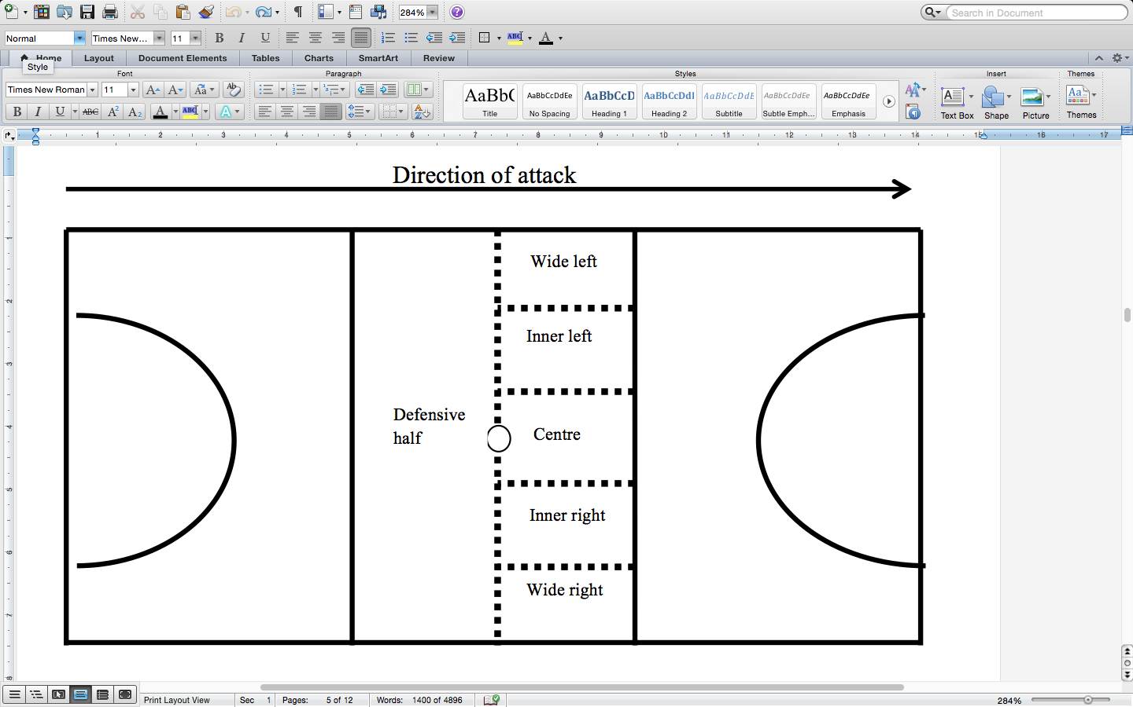
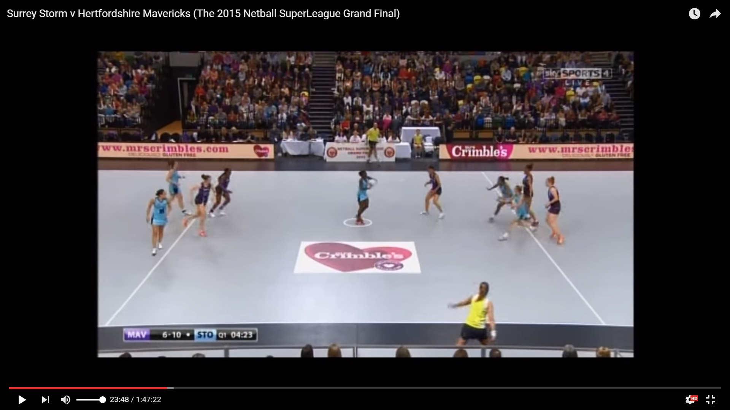
Centre Passes in the UK Netball Super League
Craig Pulling, David Eldridge and Jane Lomax
Institute of Sport, University of Chichester, UK
INTRODUCTION
Centre passes in netball are taken following a goal being scored and using the centre pass effectively is crucial for winning a game of netball (Ceccomori, 2003). Teams that can consistently move the ball forwards from a centre pass give the shooters the best chances to set up and score (Woodlands, 2006).
There is a paucity of research in relation to centre passes within netball and no previous studies have investigated the turning movement of players when receiving a centre pass. Therefore, the aim of this study was to analyse the chosen direction of turn when players received a centre pass in netball and the subsequent possession sequence.
METHOD
RESULTS
There was a significant difference in the frequency of passes that led to a shot being taken for the different turns (ᵡ²₂ = 17.273, p = 0.001). The Wilcoxon tests revealed that there were significantly less passes displayed that led to a shot being taken following a turn out compared to a turn in (T = 7, p = 0.016, r = -0.65) and a no turn (T = 0, p = 0.001, r = -0.85).
Table 1. Centre passes and received areas.
Type of turn | Def’ half | Wide right | Inner right | Centre | Inner left | Wide left
Turn in | 5 (9.4) | 37 (37.0) | 32 (36.0) | 46 (61.3) | 39 (47.6) | 59 (62.1)
Turn out | 2 (3.8) | 40 (40.0) | 34 (38.2) | 17 (22.7) | 28 (34.1) | 26 (27.4)
No turn | 46 (86.8) | 23 (23.0) | 23 (25.8) | 12 (16.0) | 15 (18.3) | 10 (10.5)
Figure 2. Centre pass areas.
Table 2. Centre passes, subsequent passes and shooting opportunities .
DATA ANALYSIS
The data are presented as absolute frequencies and some results are supported by percentage occurrence (stated in brackets).
A Friedman’s ANOVA was used to explore the differences between the types of turn displayed and the frequency of passes that led to a shot being taken. If a significant finding was evident, post hoc comparisons were completed using Wilcoxon signed-rank tests. A Bonferroni correction was applied and therefore the alpha level was set at 0.0167.
Type of Turn | Centre passes that led to a shot | Total number of passes from initial receiver to shot taken | Average number of passes following a centre pass to a shot being taken
Turn in successful | 159 | 680 | 4.28
Turn out successful | 111 | 390 | 3.51
No turn successful | 99 | 448 | 4.53
Figure 1. Centre pass.
CONCLUSIONS
The players were more likely to use a particular turn in certain areas of the court when receiving a centre pass. This could be due to the tactics applied by the defensive team (Sheryn and Sheryn, 2012) and/or the handedness of the players.
The Wilcoxon tests revealed that there was significantly less passes displayed that led to a shot being taken following a turn out compared to a turn in and no turn. This may suggest that a player who turns out may have a more direct passing option available to them for their next pass. It would be advised to develop an appropriate sequential system to further investigate the possession sequence following a centre pass (O’Donoghue, 2015). Future research should explore defensive tactics and the movement of the attacking players from centre passes.
METHOD
A total of 500 centre passes were analysed from seven games. All the games sampled were taken from broadcast coverage provided by Sky Sports television.
Centre pass variables that were explored included; the players turning direction when receiving a centre pass, the court areas in which centre passes were received (see figure 2), pass successfulness following a centre pass and the amount of passes following a centre pass that led to a shooting opportunity.
REFERENCES
Ceccomori, M. (2003), Set Plays: Organising and Coaching Dead Ball Situations. PA, USA: Reedswain Publishing.
O’Donoghue, P. (2015), An introduction to performance analysis of sport. Abingdon, U.K: Routledge.
Sheryn, A., and Sheryn, C. (2012), 101 Youth netball drills age 12-16. London: Bloomsbury Publishing Plc.
Woodlands, J. (2006), The Netball Handbook. Champaign, Illinois: Human Kinetics.

